Slide 1
GCP – Instance Groups

Slide 2
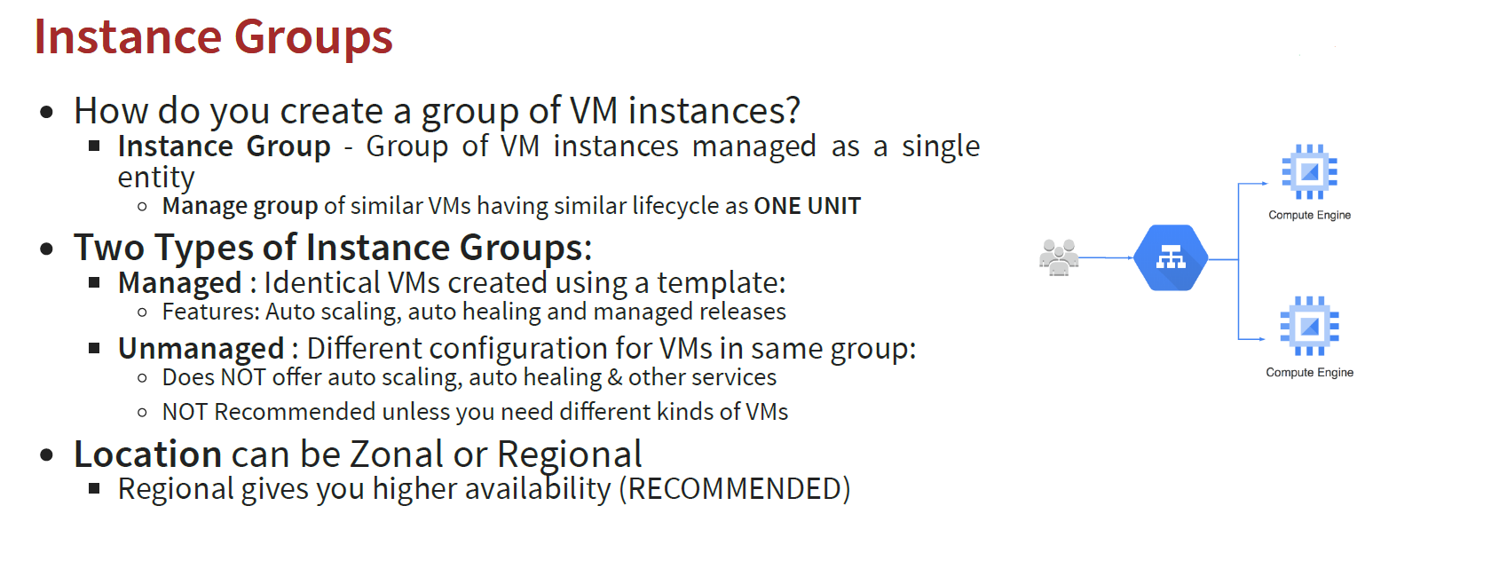
Instance Groups

Slide 3
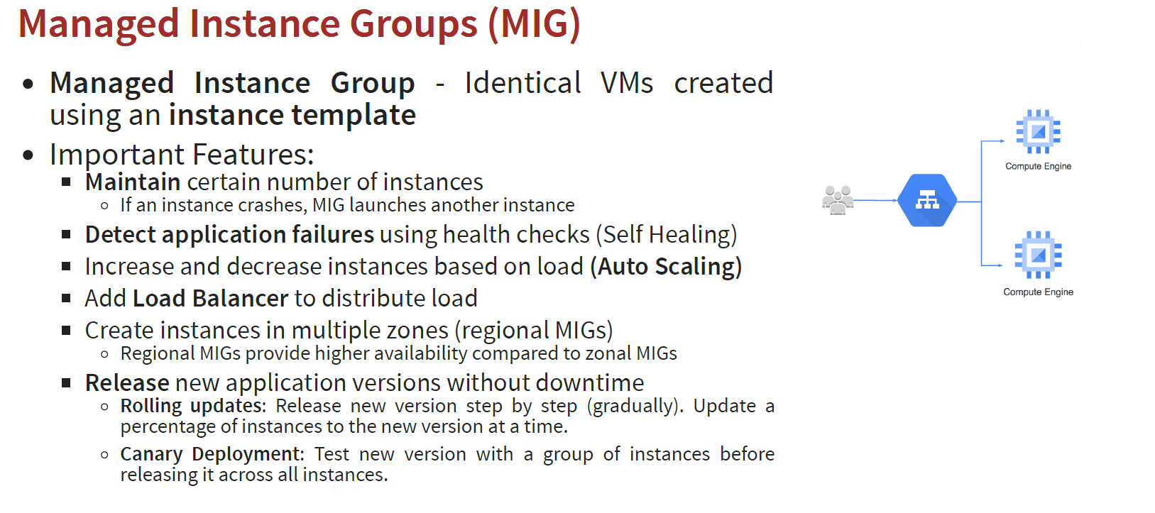
Managed Instance Groups (MIG)

Slide 4
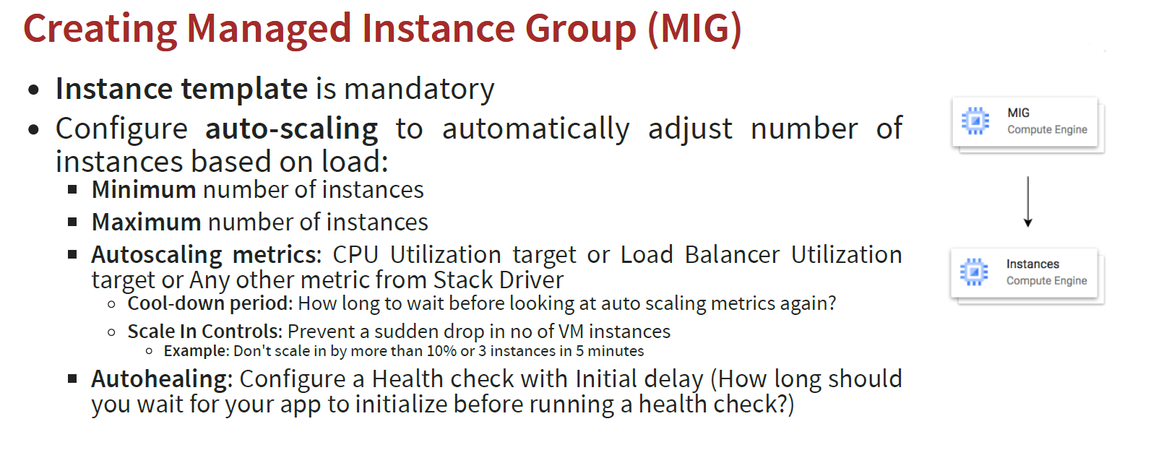
Creating Managed Instance Group (MIG)

Slide 5
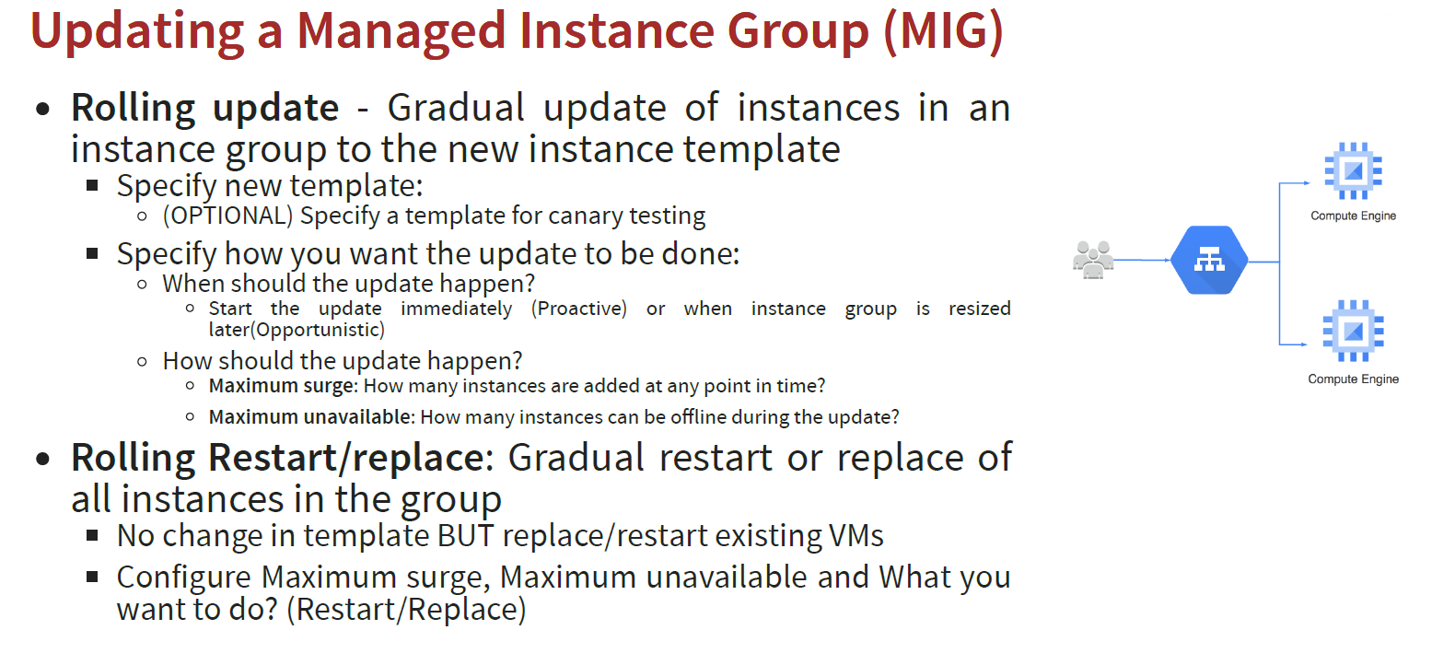
Updating a Managed Instance Group (MIG)

Slide 6
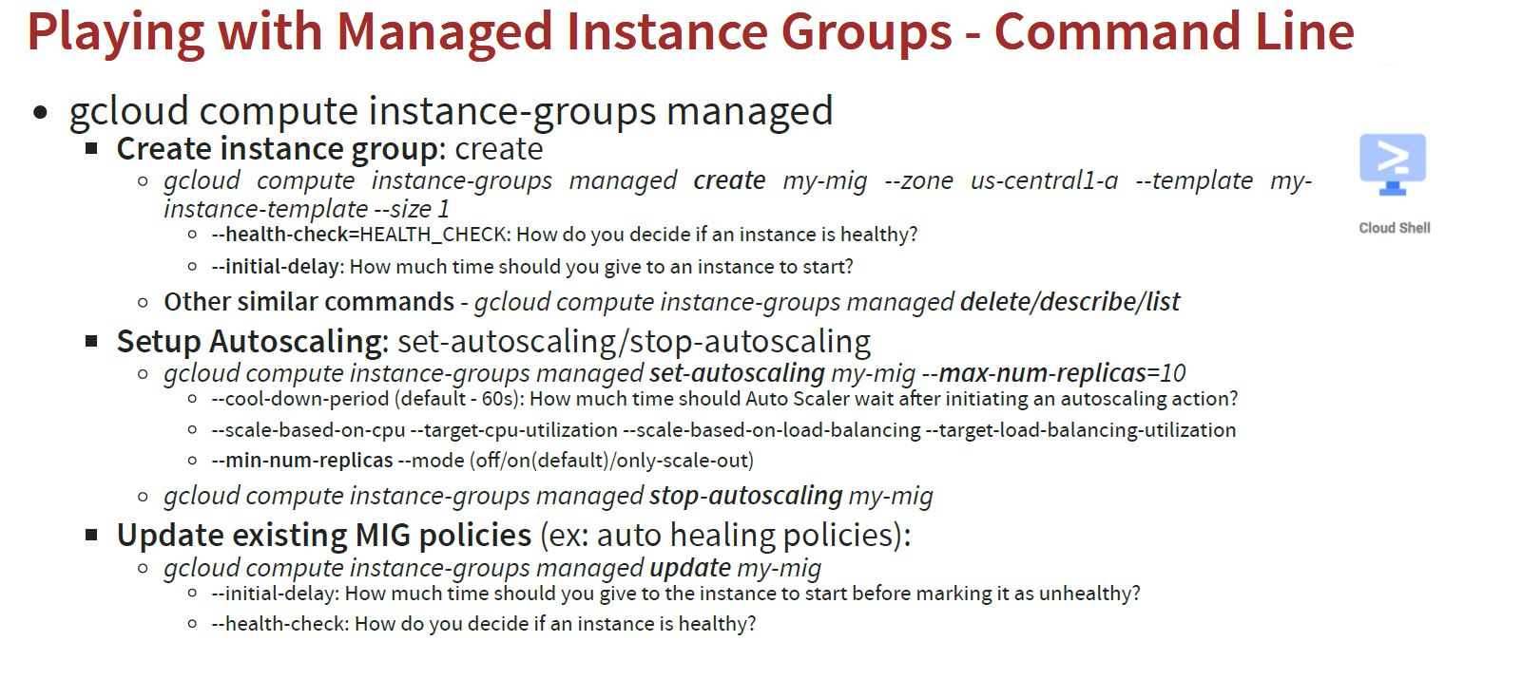
Playing with Managed Instance Groups - Command Line

Slide 7
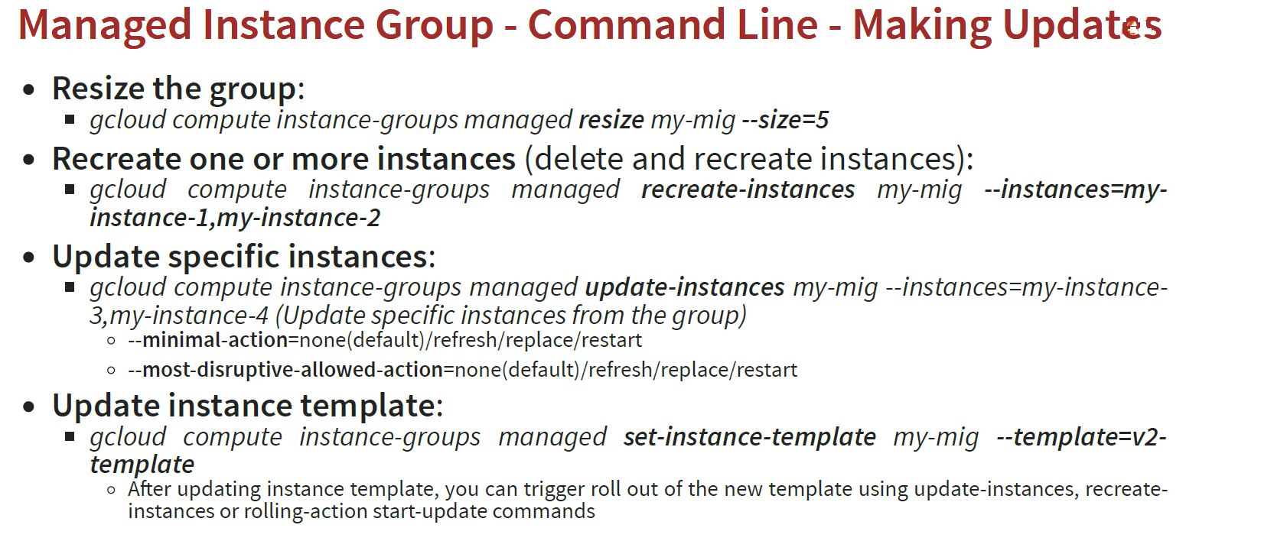
Managed Instance Group - Command Line

Slide 8
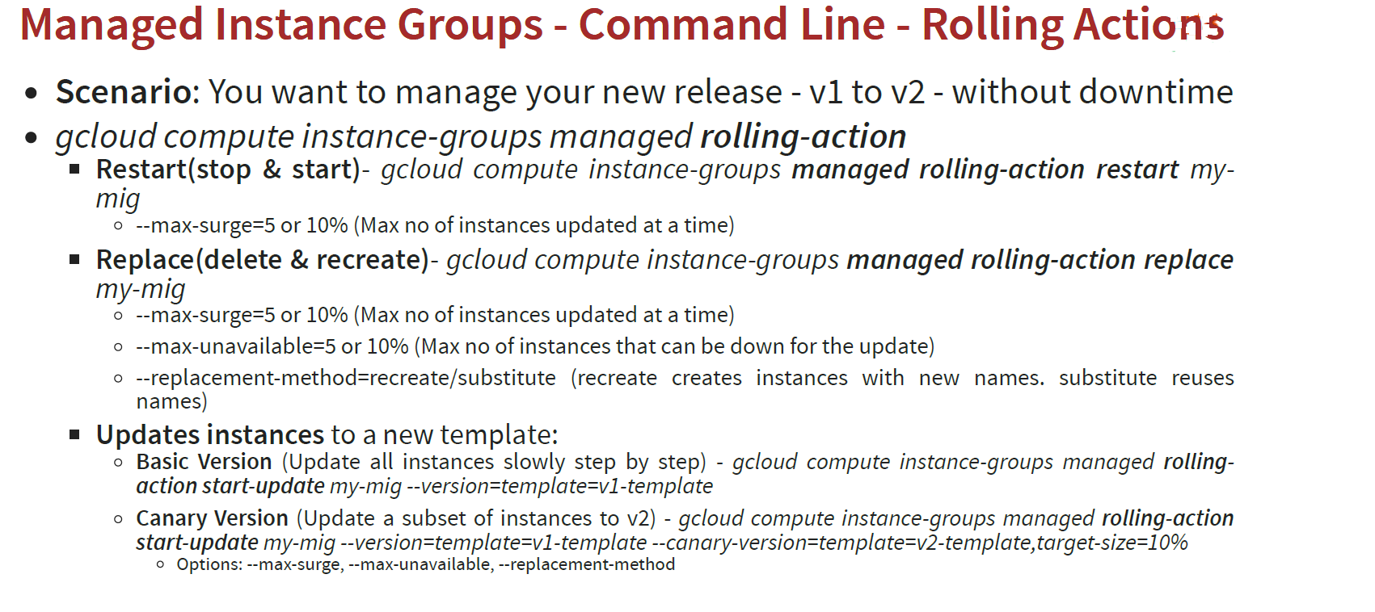
Managed Instance Groups - Command Line

Slide 9
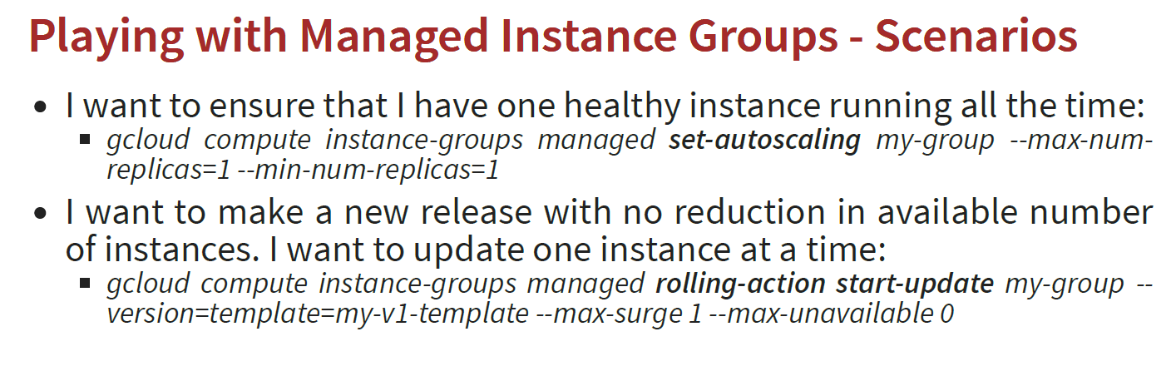
Playing with Managed Instance Groups - Scenarios

Slide 10
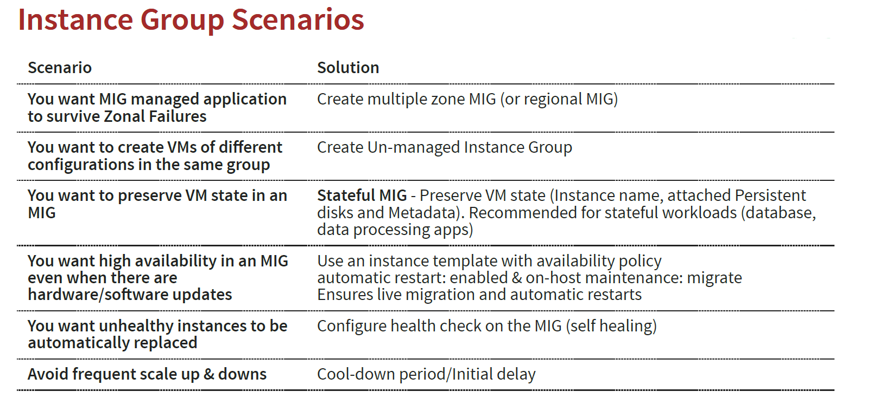
Instance Group Scenarios

Slide 11
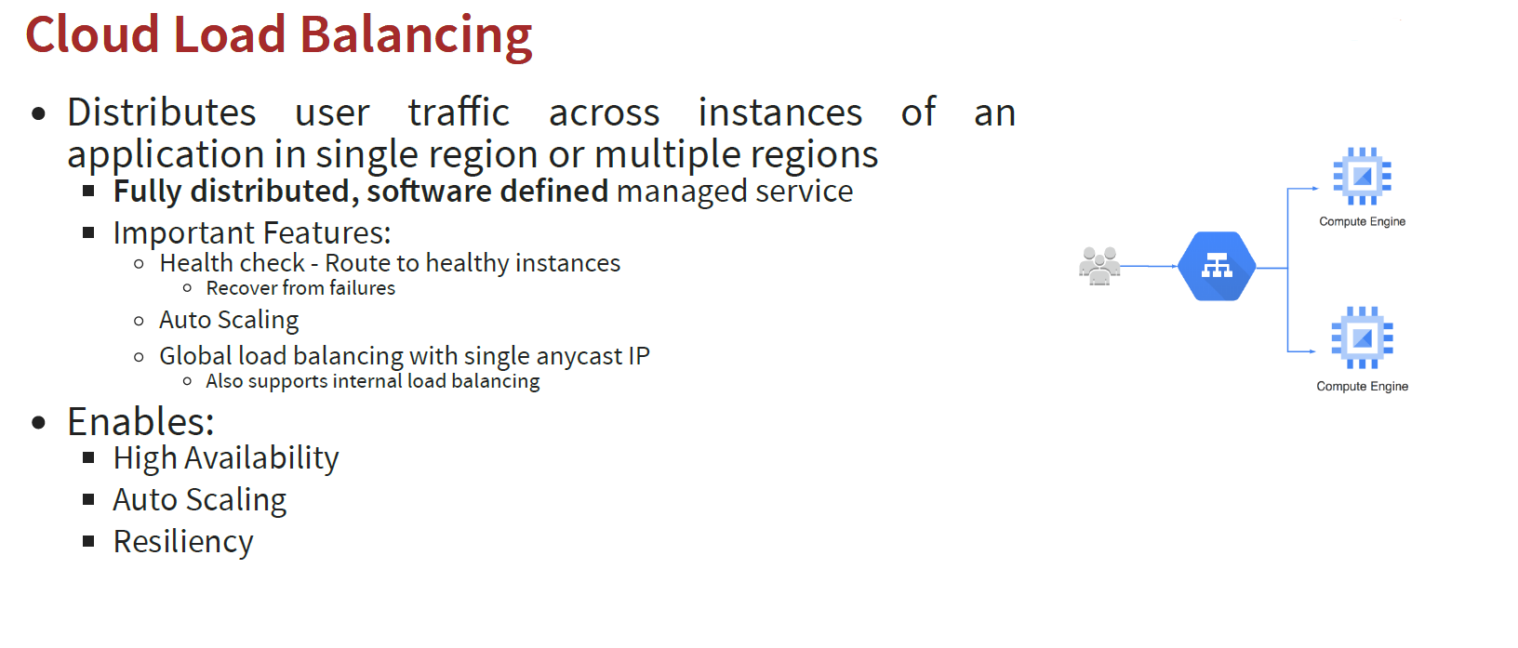
Cloud Load Balancing

